Slide 1
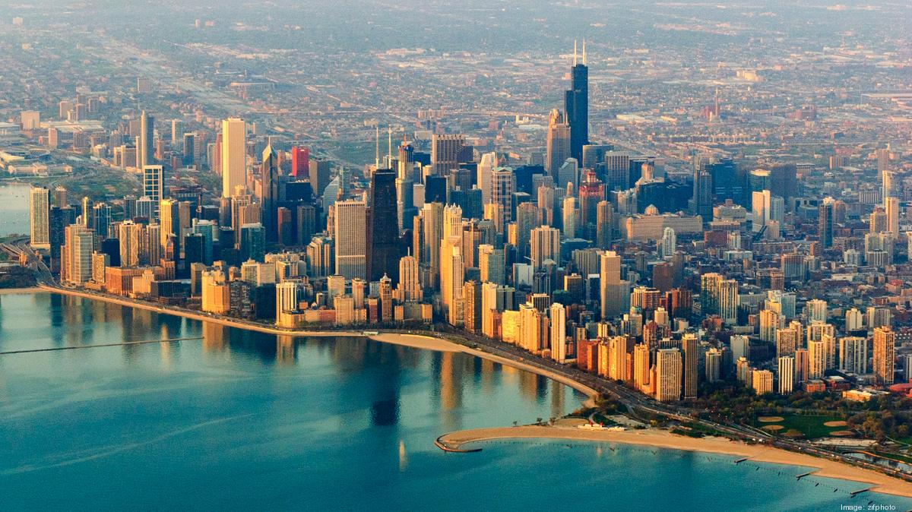
Predicting West Nile Virus in Chicago
John Han Wei Tan
Christopher Gozali
Angeline Chandraatmadja
Notes:
Good morning everyone. I will be kicking off our group’s presentation on predicting WNV in Chicago

Slide 2
PROBLEM STATEMENT
There is growing concern in the recent spread of West Nile Virus (WNV) in Chicago
DATA-SCIENCE has collaborated with the Public Health Department of Chicago to develop a predictive model for WNV occurrence.
Model optimised for screening purposes
Notes:
We begin by stating our problem statement. Due to the recent rise in cases of WNV, our team, was tasked with developing a model to predict the occurrence of WNV. Our model is to be optimised for screening purposes – which means we will be optimizing it for sensitivity ( or recall). This means we want to minimize false negatives ( predicting no WNV when there is WNV)
(DATA – SCIENCE): Disease and Treatment Agency, division of Societal Cures in Epidemiology and New Creative Engineering

Slide 3
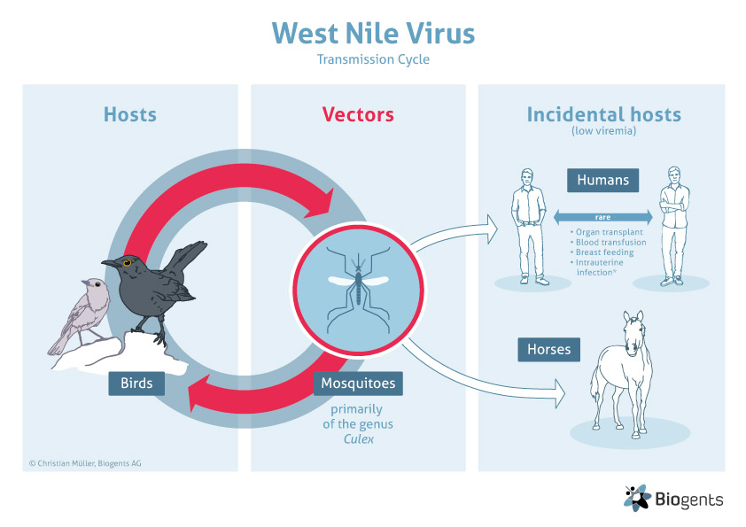
ABOUT THE WNV
1/5 of infected humans experience symptoms of WNV
Symptoms include fevers, body aches
Serious symptoms occur when virus attacks central nervous system
1/1500 fatality rate in humans.
Notes:
(SPEED THROUGH)
This is some background information about the west nile virus. The diagram on the left depicts the transmission cycle of WNV : how the virus is propagated.
Mosquitos are the main vectors for the virus. Birds are a primary source of blood for the Culex species of mosquito, and can be infected with WNV, therefore they are amplifiers of the virus.
20% of humans infected will develop symptoms, which means people infected are mostly asymptomatic.
1/150 humans develop serious symptoms where the virus attacks the central nervous system and has a 10% fatality rate. This means in total, the WNV has a fatality rate of 1/1500.

Slide 4
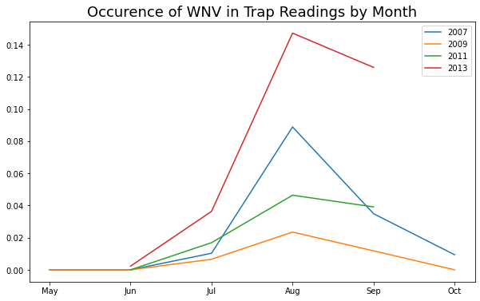
West Nile Virus peaks in August (summer months)
Notes:
Plotting our data on WNV frequency by year, we observe that WNV frequency increases during the summer months, especially in August.

Slide 5
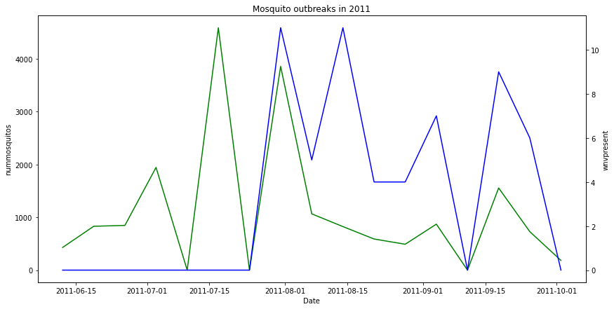
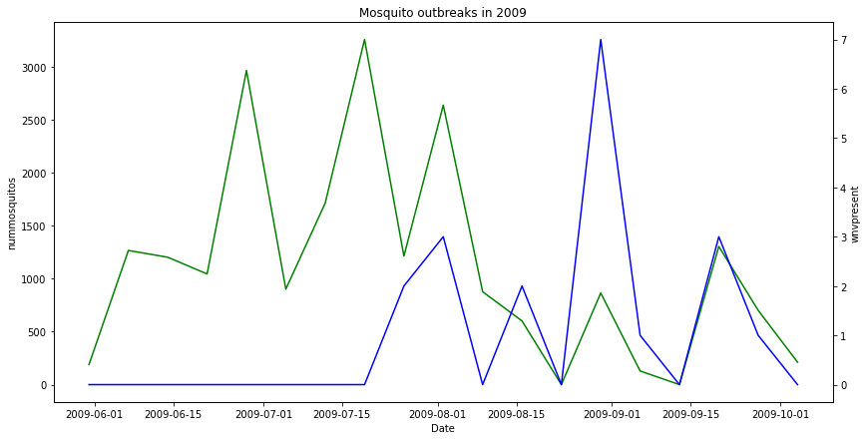
Trends
Spikes in the number of mosquitos coincides with WNV detection
Usually a time lag of between 2 – 4 weeks between peaks
Feature engineering on features related to mosquito breeding cycles and activity
Notes:
On these graphs we can see the mosquito numbers in 2009 and 2011 in green and the frequency of WNV detected in blue.
It is clear that the spikes coincide with one another. The peaks for both graphs tend to have a time lag between them of about 2 – 4 weeks.
We hypothesize that this delay reflects the breeding cycle of the Culex mosquito

Slide 6
MODEL FEATURES
Feature name | Feature Type | Rationale
species | Nominal (pipiens, pipiens/restuans, restuans) | Only two species of the Culex mosquito are carriers of WNV
tavg | Continuous | Related to mosquito activity
depart | Continuous | Related to mosquito activity
dewpoint | Continuous | Related to mosquito activity
cool | Continuous | Related to mosquito activity
daylight hours | Continuous (Engineered) | Related to mosquito activity
relative humidity | Continuous (Engineered) | Related to mosquito activity
weathertype | Nominal (ra, hz, br, fg, ts, vc, dz) | Related to mosquito activity
preciptotal | Continuous (Engineered) | Related to mosquito breeding
stnpressure | Continuous (Engineered) | Related to rainy season
sealevel | Continuous (Engineered) | Related to rainy season
resultspeed | Continuous (Engineered) | Related to rainy season
Notes:
Total of 20 features (accounting for nominal features
)
Generally, the features we selected describe mosquito biting activity or breeding, including several engineered features.
I will elaborate further on these features in the next few slides

Slide 7
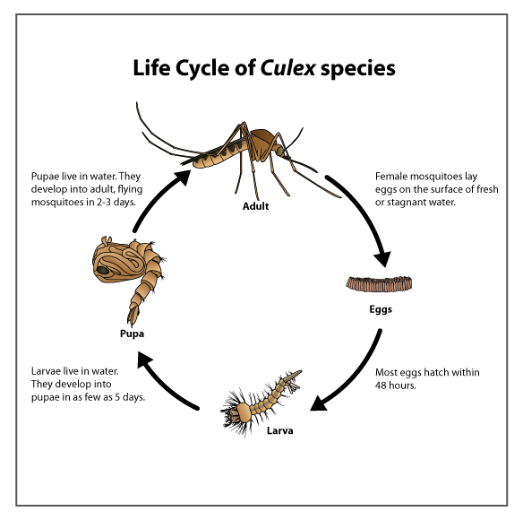
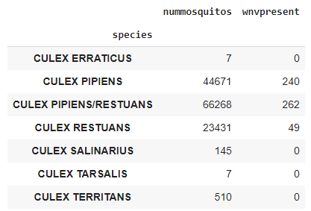
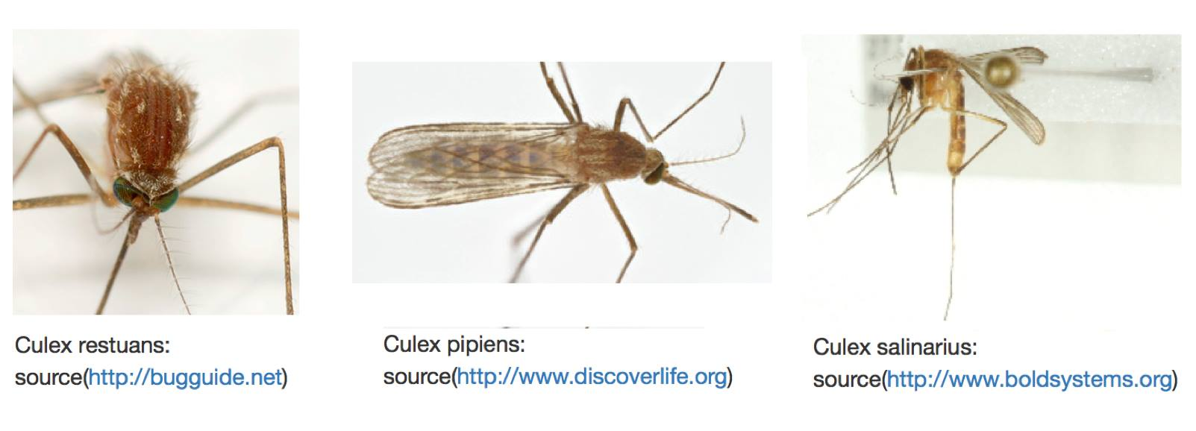
Species
10 Days
Notes:
Only 2 species of mosquito carry WNV – Culex pipiens and Culex restuans. We created dummy features to represent each of these 3 categories.
From the diagram on the right, the culex species takes about 9 – 10 days to develop into an adult from its egg. This means it takes about 10 days for a mosquito which is infected with WNV to transmit the disease into its offspring and manifest in the environment.

Slide 8
Engineered Features
Daylight Hours
Relative Humidity
Lagged and Rolled features
Preciptotal
Stnpressure
Sealevel
Resultspeed
Notes:
Next I will be going through the engineered features.

Slide 9
Daylight Hours
Culex species are not active during the day
Greater mosquito activity on longer nights
Daylight hours engineered by calculating time between sunset and sunrise
Notes:
First of all, daylight hours.
Researched showed that the key transmitters of WNV only bite at night (Culex mosquitoes do not bite during the day).
With that in mind we engineered this feature to represent the hours of daylight each day from the sunset and sunrise

Slide 10
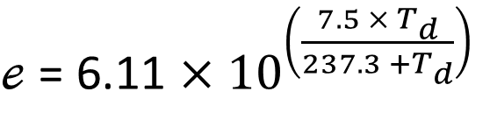
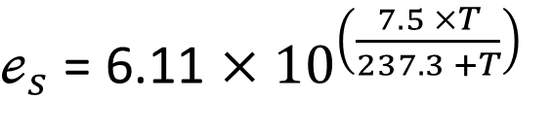

Relative Humidity
Relative humidity estimated by using dewpoint and tavg to calculate vapour pressure at atmospheric conditions.
Symbol | Meaning
e, e_{s} | Actual vapour pressure, Saturated vapour pressure
T, T_{d} | Temperature, Dewpoint Temperature
Notes:
Relative Humidity is calculated by estimating the vapour pressure of water using the original features tavg and dewpoint.
RH is impt because mosquitoes are more active when the weather is humid
The equations used is an approximation of the Clausius-Clapeyron equation.

Slide 11
Lag and roll
Preciptotal:
Rain forms pools of stagnant water which is deal for mosquito breeding
10 day lag to account for Culex lifecycle
Stnpressure, Sealevel, Resultspeed:
Features describe atmospheric pressure and wind vector sum (speed and direction)
Related to wet/dry seasonality
28 day lag
7 day rolling average
Notes:
Preciptotal was engineered by taking 10 day lag to account for how long it takes for a new generation of mosquitos to emerge after a period of rain
Stnpressure, sealevel measure atmospheric pressure at station altitude and at sealevel respectively. Resultspeed is a vectorsum that accounts for wind speed and direction
These conditions are lagged by 28 and 7 day rolling average used to generalize the features to account for rainy seasons.

Slide 12
MODELLING

Slide 13
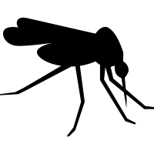

STRONG FEATURES
Strong Logistic Regression coefficient or Random Forest high feature importance
dewpoint – Log reg
tavg – Log reg
daylighthours – Random Forest, Log Reg
Mosquito Activity
resultspeed_roll7_lag28 – Random Forest
stnpressure_roll7_lag28 – Log Reg
Rainy Season
Notes:
Notable features: daylight hours, culex restuans, stnpressure_roll7_log_28, tavg

Slide 14
GRIDSEARCH
Models chosen:
Logistic Regression
Random Forest
Ada Boost
Gradient Boost
Neural Network
The models are optimized over AUCROC score
Notes:
When predicting diseases we always want to be safe than sorry. As such we will choose the model with the highest recall, as we want a model that best predict the presence of WNV.
Train roc auc

Slide 15
SELECTION CRITERIA
RECALL
We are interested in the positive class (WNV present), recall captures the true positive rate.
Less Overfitting
Small difference between train and validation AUCROC score

Slide 16
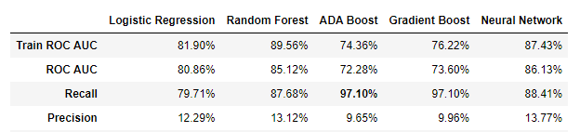
MODEL SELECTION
MODEL EVALUATION
Precision is low for all methods because the presence of WNV is generally impacted with changes in weather
ROCAUC scores for Kaggle unseen dataset is lower than the validation data
Models are overfitted on 2007, 2009, 2011, 2013 data (train dataset)
 | Holdout AUCROC | Kaggle AUCROC
ADA Boost: | 79.55% | 66.84%
Notes:
When predicting diseases we always want to be safe than sorry. As such we will choose the model with the highest recall, as we want a model that best predict the presence of WNV.
Train roc auc

Slide 17
SPRAY RECOMMENDATIONS

Slide 18
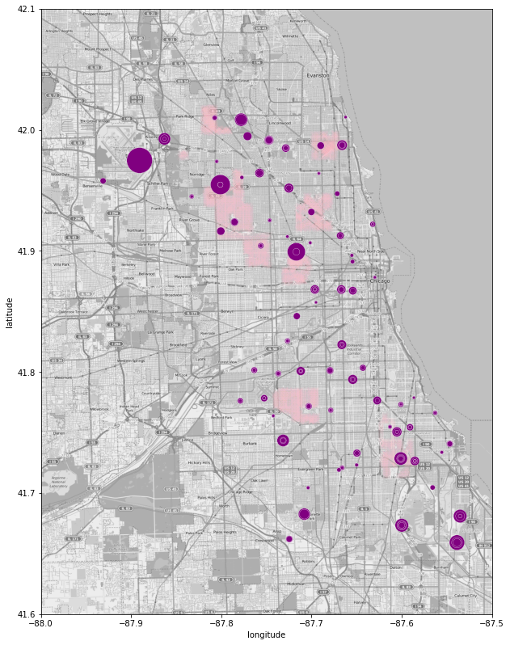
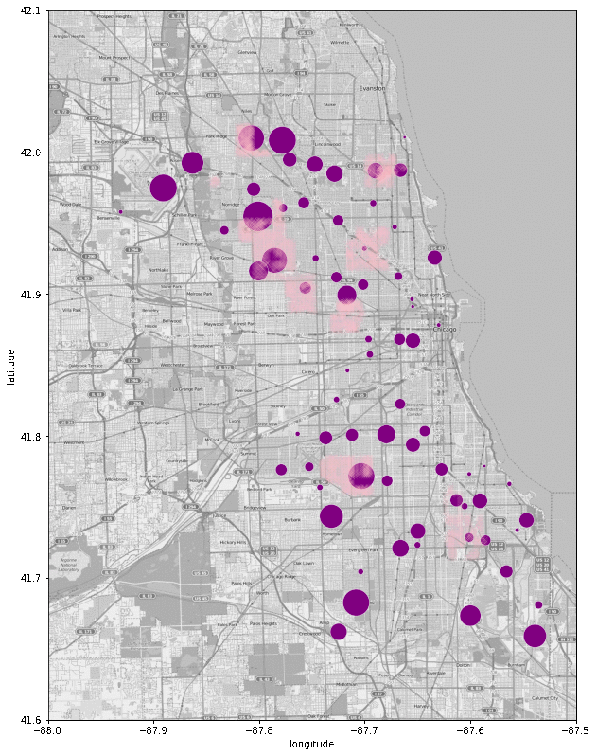
Exploring the effects of spraying
1 week before spraying starts (Aug 8):
Aug 8 to September 14
Mosquito Density in Traps
Areas sprayed on Aug 8 once week to September 5
Notes:
Before we make the spraying recommendation
Mosquito population increase after awhile, which shows that we didn’t properly get rid of the breeding sites.
Lack of spray data, we don’t know if they continue to spray after the dates within our dataset
Only given spray data in 2013

Slide 19
Recommendations
Additional pesticide application targeting mosquito larvae/pupae
Apply onto areas which may accumulate rainwater
Apply when rainy/wet to prevent mosquito numbers from spiking 2 weeks later.
Conduct spraying during summer months (July – September)
Notes:
Our knowledge on mosquito population and presence of west nile virus is limited To overcome to the location of the traps
We might be overly focusing on areas with traps
we may look at addresses of patients who have contracted WNV to identify potential blindspots

Slide 20
Project Limitations
Model has low precision as we have over relied on city wide weather conditions
Difficult to predict presence of WNV in specific areas of interest
Notes:
Our knowledge on mosquito population and presence of west nile virus is limited To overcome to the location of the traps
We might be overly focusing on areas with traps
we may look at addresses of patients who have contracted WNV to identify potential blindspots

Slide 21
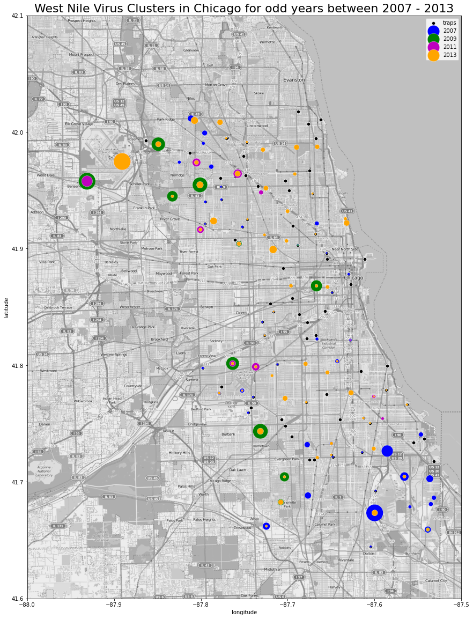
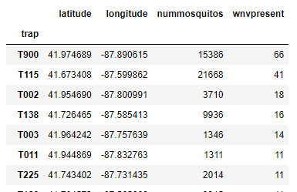
WNV Hotspots
T900
T002
* Color represents year,
* Dot size represents population size of mosquito found in traps
T115

Slide 22
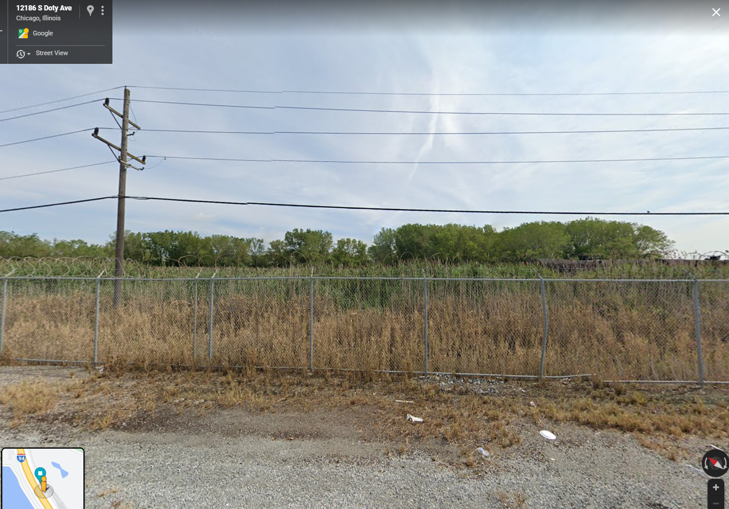
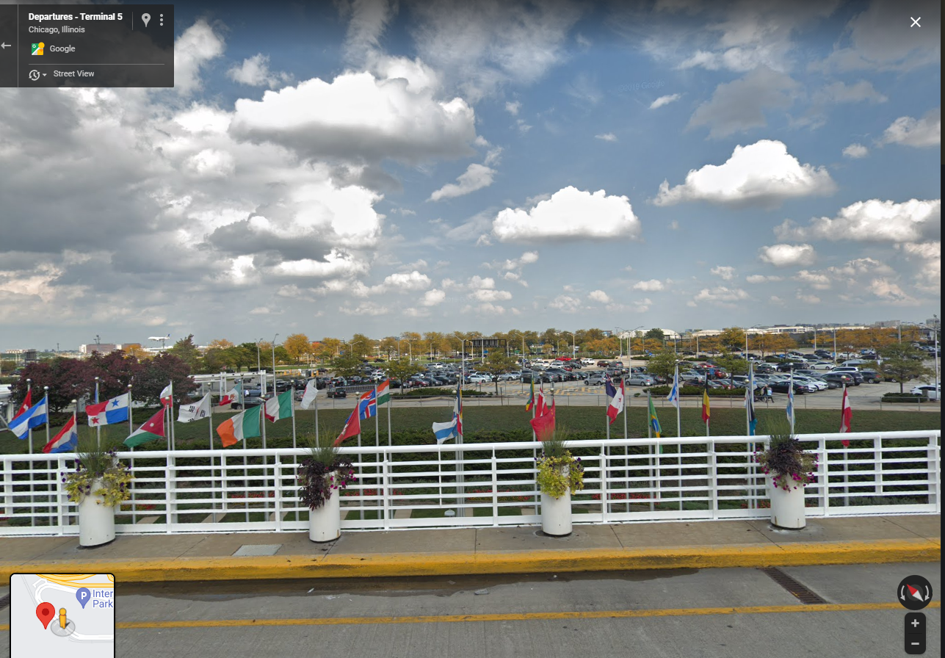
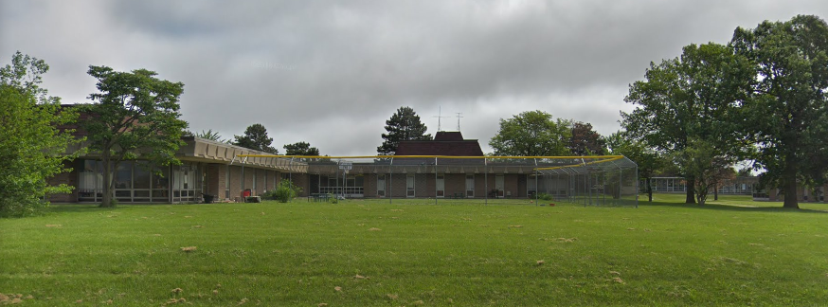
T115
WNV Occurrence: 41 Nummo Mos: 21668
T900
WNV Occurrence: 66 Nummo Mos: 15386
T002
WNV Occurrence: 18 Nummo Mos: 3710

Slide 23
Future Work
Include localized environmental data besides weather
Current features make it difficult to predict local clusters
E.g. extent of urbanization, population density
Include more spray data
More data will help in conducting a more rigorous analysis on spray effectiveness
Combine different models to create ensemble model
40% Logistic Regression and 60% ADA boost improved Kaggle score to 0.706
Notes:
A major limitation of our model is that our inputs are based on average city-wide weather conditions. This does not allow us to predict localized mosquito clusters, making it difficult to narrow down our predictions to specific areas of interest. To overcome this limitation, we can include additional data which describe localized environmental features that could depict the extent of urbanization, or footfall/population density of the particular area etc.
2) More spray data can be included to better evaluate the effectiveness of the current spraying strategy, and conduct a cost/benefit analysis for spraying to gain further insights on how to improve on the current program.
3) We can combine the predictions from different models to incorporate the strengths of multiple models into our final model. For instance, XMODEL gave the best sensitivity while YMODEL performed best in terms of minimal overfitting. By combining the predictions from these two models, we can create an ensemble method which combines the benefits of using each.

Slide 24
Thanks!

Slide 25
ADDITIONAL SLIDES 1
Strongest features: Daylight hours, stnpressure_roll7_log_28, tavg
Models optimized using AUC-ROC score and selected based on high recall (sensitivity).
Optimising for sensitivity helps to minimize false negatives
Good for screening
Project Limitations:
Limited spray data
Low precision
Notes:
1) Strongest features predict weather conditions for mosquito breeding/activity
2) Optimizing for sensitivity makes sure that when WNV is present, we predict TRUE as much as possible.
3) Limited spray data makes it difficult to evaluate the effectiveness of the current spraying strategy
4) Features used describe the weather for the entire region (city) thus we are predicting the probability of WNV for the entire city. Difficult to make localized predictions

Slide 26
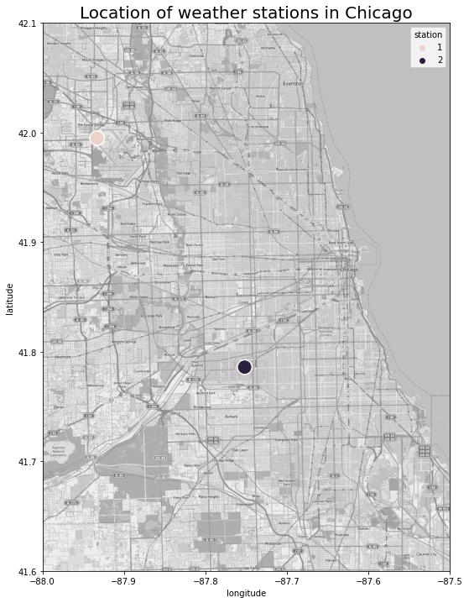
ADDITIONAL SLIDES 2
Combine weather station data since there are minimal difference between the results from each station. Geographically close enough that we can ignore
Notes:
The weather data for the stations is aggregated in the following ways:
1) For numerical features, take the average of both stations
2) For numerical features with missing data, we impute missing data with the other station data on the same day.
3) For variables only captured in 1 station, we assume that the results will be the same for the other station.
4) For weather types, we assume that the weather type captured by either station will apply to the other station.

Slide 27
ADDITIONAL SLIDES 3
Notes:
Notable features: daylight hours, culex restuans, stnpressure_roll7_log_28, tavg

Slide 28
ADDITIONAL SLIDES 4
There are hotspots where west nile virus has high occurrence.
T900
T002
521.3
T115
621.3

